Slide 1
Analysis of Outpatient Antenatal Clinic Appointments’ Data
Chikaodili Deng

Slide 2
Presentation Outline
CONCLUSION
OBJECTIVES
RECOMMENDATIONS
DATA QUALITY ISSUES
IMPORTANT INFORMATION TO CONSIDER

Slide 3

Objectives
Analyse outpatient antenatal clinic
appointments for maternity service
over a 6-month period.
Support the service in assessing their efficiency in running these clinics.

Slide 4
Important Information to consider

Slide 5
Important Information to consider

Slide 6
Important Information to consider

Slide 7
Important Information to consider

Slide 8
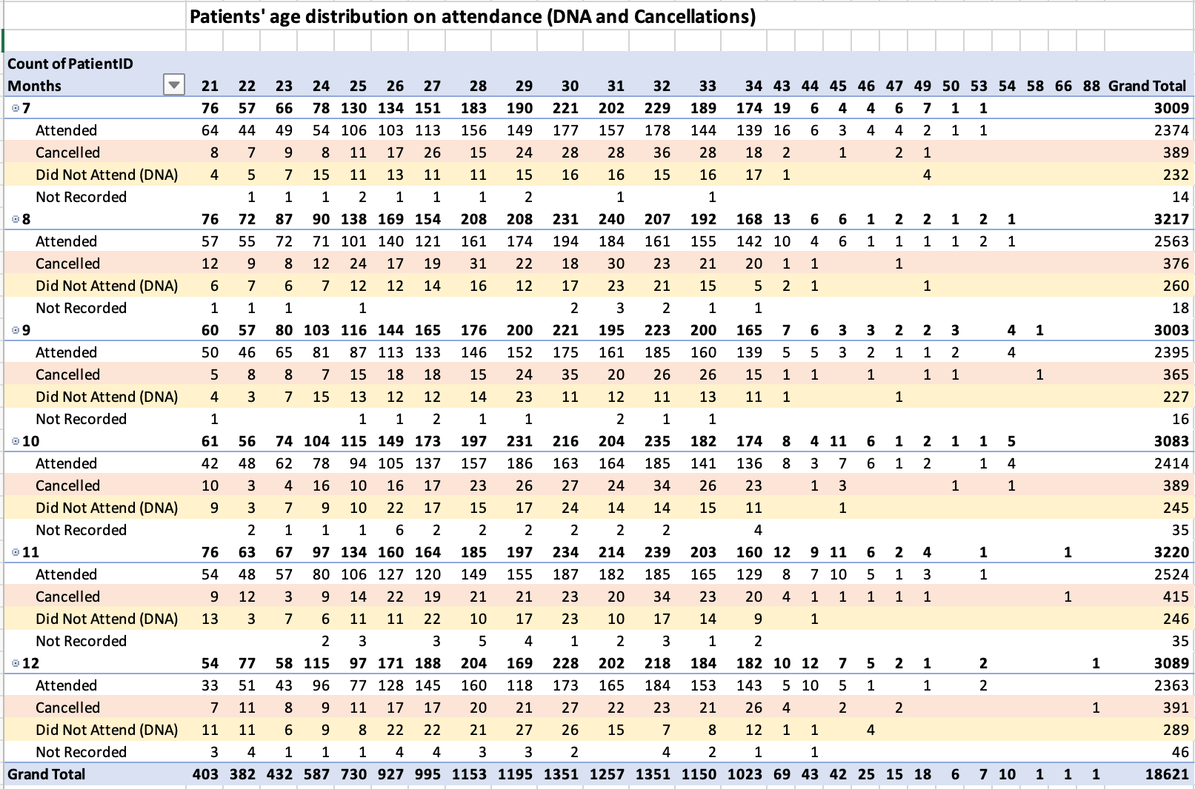
Other information to Highlight

Slide 9
Data Quality Issues
Incomplete information
Duplicates
Inconsistent formats
Missing data
Absence of data dictionary

Slide 10
Recommendations
Reduce the days’ notice for clinic appointment.
Send out reminders before the appointment time.
Sensitize clients on the importance of antenatal care.
Harmonize data from different sources.
Use standardized instruments for data capture.
Identify and adopt best practices.

Slide 11

Conclusion
Other audiences to present this information to and type of presentation.
Medical Officers and Consultants (30 minutes punchy power point presentation)
- Management Authorities
(Fact sheets, advocacy kit)
Beneficiaries and clients (Flyers, fact sheets)

Slide 12
Thank you !!!
mchikky@yahoo.com

